Slide 1

Clean Water to every household
Prepared for Hult Prize 2018
Boston Campus
November 2017

Slide 2
Let’s see two pictures

Slide 3
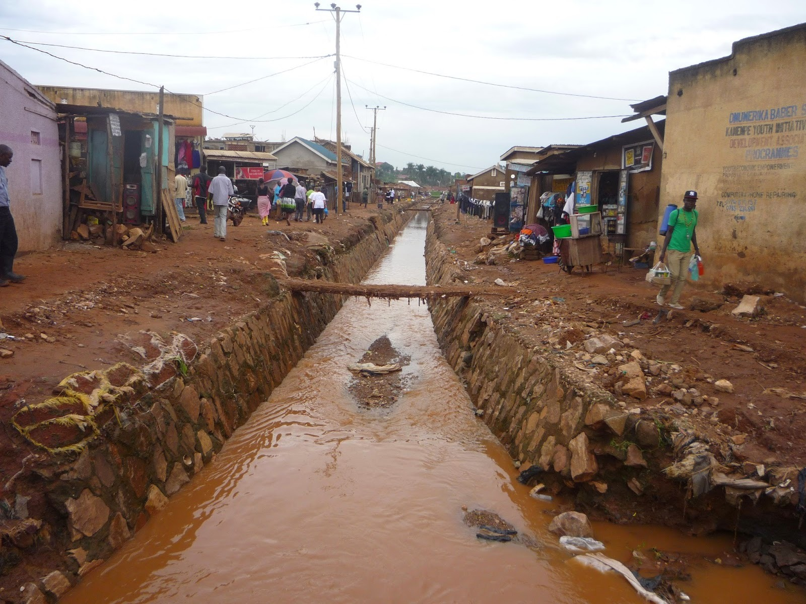
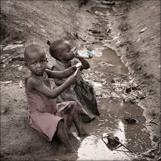
Polluted water
Waterborne disease – Diarrhea
1.8 million deaths every year
1.4 million Children under five years die each year
Notes:
How the water is polluted:
Faecal-oral pathway (contamination of drinking-water catchment areas)
Inadequate disposal of human or animal waste
Contamination in the distribution system
Unhygienic handling of stored household water
Exposure to unsafe concentrations of chemical contaminants
-85% of diseases in African toddlers are due to a lack of clean drinking water
-159,000,000 people relying on only surface water live in Africa
-319 million people living in Africa don’t have regular access to clean water
-695 million people in Africa live without clean sanitation options
-42% of all the healthcare facilities in Africa don’t have drinking water
-in Africa, 650 people a day die from water-related diarrhea
-only 16% of people living in sub-Saharan Africa have access to water taps
-30% of the water supplies only 10% of the population

Slide 4
WHICH KInD OF water would you
DRINK ?

Slide 5
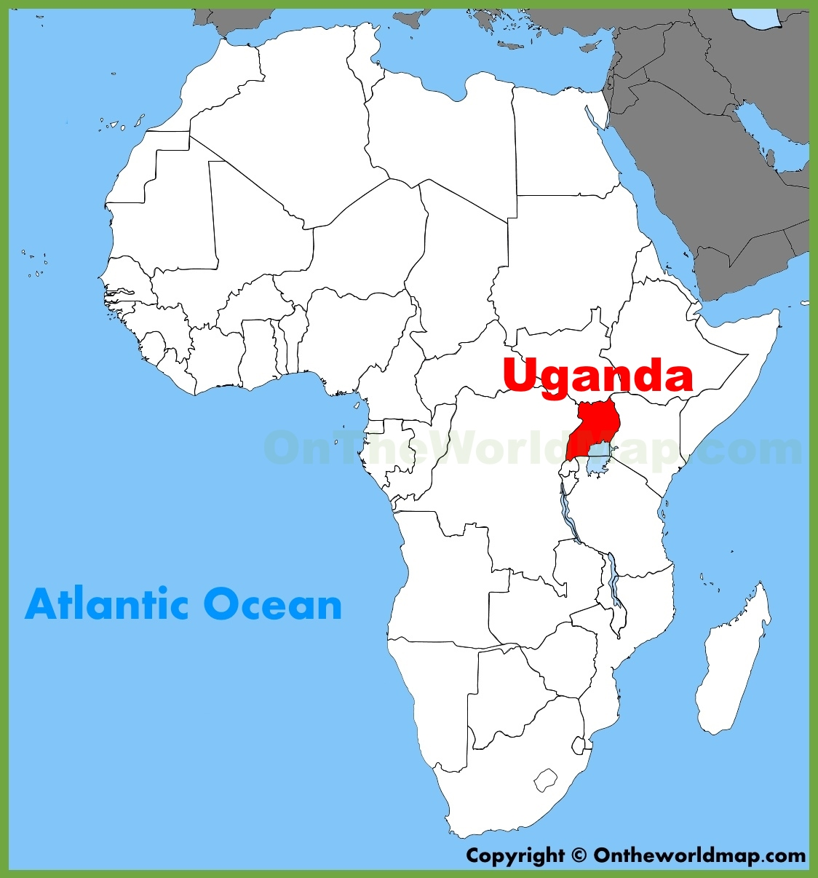
Target Country
UGANDA
Capital: Kampala
Population of 39 M
29 M lack access to improved sanitation
Source of water: Lake Victoria, Lake Albert, Lake Kyoga, Lake Edward, Lake Kwania, Lake Bisina
Notes:
Uganda has 10th highest population in Africa

Slide 6
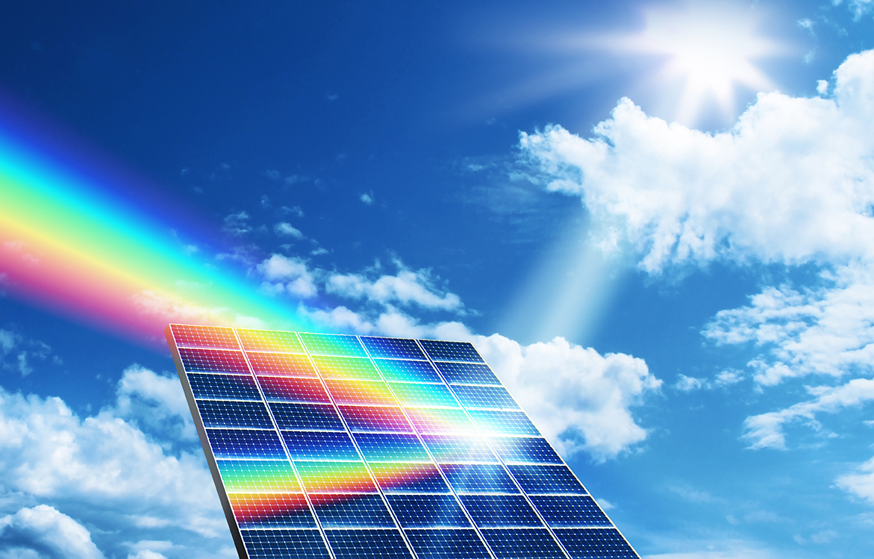
Wawa concept
Solar energy
Gravity
Simple technology

Slide 7
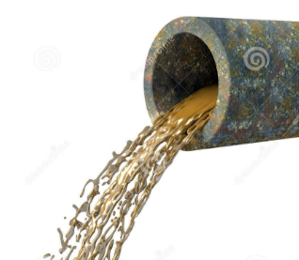

How wawa works
Dirty / Polluted Water
Solar Power
Filter
1. Filtration of major particles
Glass Cover
3. Condensation
Water Vapor
Distilled Water Collected
2. Evaporation
Dirty filtered water
Notes:
Advantages compared to others:
Cheaper compared to huge water plant constructions.
Use of renewable energy instead of electricity (factories).
No pollution.
Affordable (plastic).
Better quality of water in comparison to simple filters.
Removal of chemicals, metals and various sediments by evaporation and condensation.
All in one.
Opportunity and challenge:
Requires solar energy
Time consuming PROCESS
Need support from government, ngo, charity ORGANIZATION ETC.
Affordable product (INVESTMENT AND MANUFACTURE)
Local partners (logistics AND PROMOTION)

Slide 8
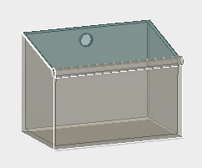
WAWA 1
0.9 m

Slide 9
WHO are the users
Uganda
Uganda
Uganda
Kanya
Uganda
Kanya
Gahana
2024
2023
Uganda
Kanya
Ghana
Rawanda
Haiti
Ethiopia
Tanzania
More….
2022
Uganda
Kanya
Ghana
Rawanda
Haiti
Ethiopia
Tanzania
2021
Uganda
Kanya
Ghana
Rawanda
Haiti
2020
2019
2018

Slide 10
Sales target
4 million product sales in total with average family member of 4
Clean water for 16 millions people
16 million filters sold in 2023

Slide 11
How we Make Profit
$30
Product Price
$22
Product Cost
$8
Product Profit
$3
Filter Price
$2
Filter Cost
$1
Filter Profit

Slide 12
Financial projection
Notes:
Change the filter every 3 months
Break down of the numbers:
Whos paying the 30 dollars, how much to replace the filters
Focus on Uganda, what are the govt and other organizations are doing in Uganda.
Business model, who are we targeting? Our target market.
How are we gonna spend the million dollars?
How are we gonna clean containers?
Why has no one done it?

Slide 13





Potential Strategic Partners

Slide 14

Sponsors
CIGEI SAC – Peruvian company specialist in manufacturing and commercialization of filter means, waste water treatment technologies, chemical additives, etc.
Press Filter
Plates and Leafs for filtration

Slide 15
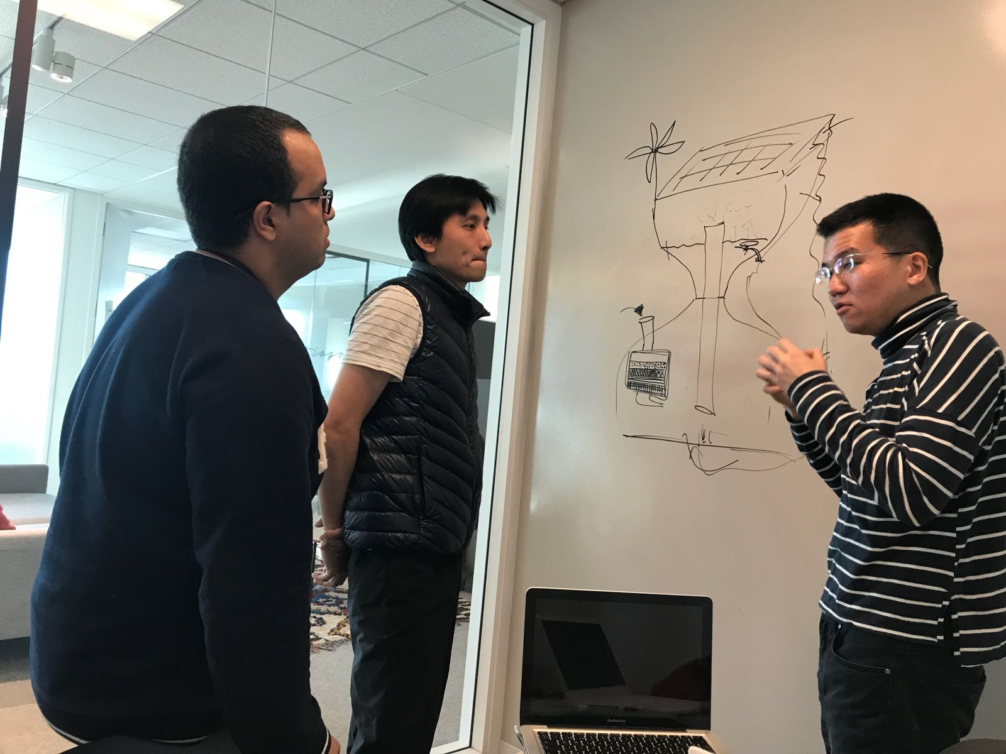

Follow us - project wawa team
FACEBOOK
@Project WAWA(group)
Website
www.projectwawa.tk
LYNN XIAOLIN ZHENG
GASTON QUINONES / GARY LEE / David Sheu

Slide 16

QUESTIONS & ANSWERS
THANK YOU!

